Slide 1
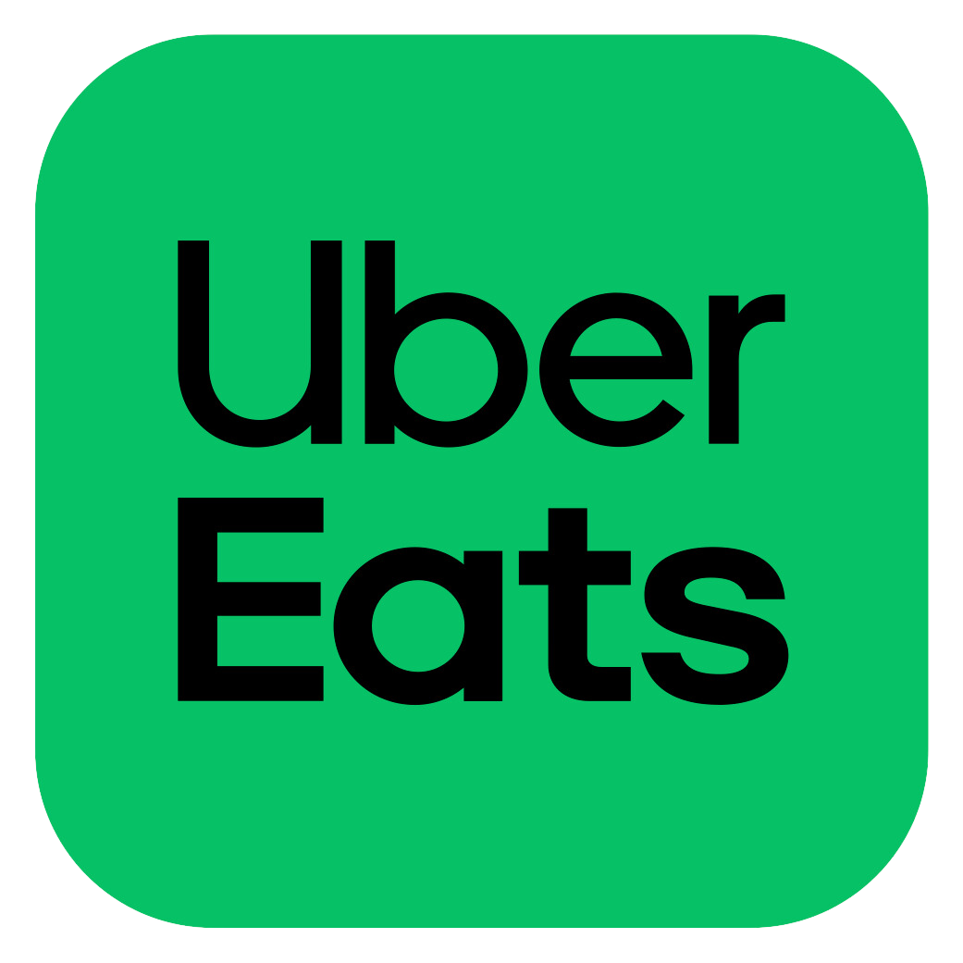
Business Review -
Honest Green
Mayli Lafortune
Account Manager, Uber Eats

Slide 2
Performance Review
All locations March 2023 - March 2024
$365,100
9,343
13%
Total Sales
Completed Orders
New Customers
Avg Basket Size
Defect Rate
Key Metrics Highlights Dashboard
16,561
$22.43

Slide 3
Key Strengths + Areas of Improvement
Chamblee
Downtown
Decatur
Strengths: Strong new customer requisition, highest earning location, and consistent sales growth MOM
Areas of Improvement:, low ad spend impact (avg online time)
Strengths: Strong new customer acquisition, good online time percentage.
Areas for Improvement: Lower visibility on the feed
Strengths: Good average basket size, low defect rate, higher ROI on Restaurant Ads Spend
Areas for Improvement: High merchant cancellations, lowest earning location, highest defect rate
Notes:
By addressing these areas, you can significantly reduce their defect rate, leading to higher customer satisfaction and improved operational efficiency

Slide 4
Marketing Plan
Loyalty Program
BOGO Variations & Seasonal Offers
Targeted
Advertising
Customer
Engagement
Promotions
Run effective promotions such as BOGO, percentage discounts, and free delivery to attract new customers and boost sales during slow periods
Align promotions with health related holidays to capitalize on increased consumer spending.
Expand Audience
Use sponsored listings to ensure Honest Green appears at the top of search results, enhancing visibility.
Targeted Ads: Utilize to reach specific demographics, ensuring your promotions reach the right audience at the right time.
Positive Reviews
Uber Eats offers a seamless ordering experience, making it easy for customers to place orders and enjoy Honest Greens’ offerings.
Encourage satisfied customers to leave positive reviews, which boosts the restaurant’s reputation and attracts more customers.
Rewards Program
Implement loyalty programs through Uber Eats to incentivize repeat purchases and build a loyal customer base.

Slide 5
Key Takeaways
Sales: All three locations show a positive trend in total sales over the past year, indicating overall growth.
Completed Orders: The number of completed orders has steadily increased, reflecting operational efficiency and customer satisfaction.
Customer Acquisition: There has been a consistent influx of new customers, suggesting effective marketing and customer acquisition strategies.
Defect Rate: The defect rate isn’t very high, however, this give the opportunity to make some changes to decrease the number. Doing so will demonstrate high service quality and efficient operations.
Merchant Cancellations: Minimizing merchant cancellations will indicate a stable and reliable service offering.
Visibility Concerns:
Increase use of Uber Eats promotional tools, such as sponsored listings and targeted ads.
Optimize online hours to ensure peak visibility.
Encourage customer reviews
Marketing Strategy for Next Month
BOGO offers and seasonal variations
Compelling descriptions / High resolution photos
Promotions (Free Delivery over $45, Spend 30 save $5, Free item after $50 purchase)
Rewards Program
Targeted Advertising
Notes:
By focusing on these key areas and implementing the recommended strategies, we can enhance your presence on the Uber Eats platform, attract more customers, and achieve sustained growth across all locations.

Slide 6
Action Plan
Continue with BOGO offers and introduce new variations to keep promotions attractive.
Implement the proposed marketing strategies to enhance visibility and customer engagement.
Increase use of Uber Eats promotional tools, such as sponsored listings and targeted ads.
Optimize online hours to ensure peak visibility.
Minimize the defect rate and decrease the merchant cancellations.
Schedule bi-weekly check-ins to monitor progress and adjust strategies as needed.
Continuously analyze performance data to identify areas for improvement and capitalize on growth opportunities.
Q&A
Notes:
I’d like to open the floor for any questions or feedback you may have

